Slide 1
BigData Spark – Hands-On Optimisations SQL Execution Plan, DAG, SparkUI Performances
Arnaud Nauwynck
Esilv 2025

Slide 2

Objectives of Hands-On
Reminders:
Local Install, spark-shell Spark File IO
MetaStore tables
1/ Execution Plan, SQL Explain / dataset.explain
2/ Spark UI, DAG, Narrow/Wide Transformations
3/ RDD cache / checkpoint
4/ Partition Pruning / Columns Pruning / Predicate-Push-Down
5/ Parquet Optims ( Sort, Stats, Dictionary, Bloom, BlockSize)
6/ perfs: SpillToDisk, JOINs, hint

Slide 3
Reminder Hands-On 1
Set JAVA_HOME
Set SPARK_HOME set PATH
JVM
WinUtils
Transform, filter
Setenv.bat
DataFrame=Dataset[Row]
Pre-Requisite
Val ds = spark.createDataset()
Spark.tar.gz embedded Hadoop
ds.show(10, true)
DataSet
Installation
User-defined
Hadoop.tar.gz
Immutable
Spark-Shell
Interactive
Windows error?
avoid
for () {} loop
Functionnal
Code Style
History
Seq
.map
lambda
Up / Down
Scala>
Repl
:help
TAB TAB autocompletion
Line compiled to scala
Eval on <enter>
val i =
var i =
Seq()
Tuple
On JVM
~Java
Numbered result « res0,res1,.. »

Slide 4
Reminder Hands-On 2
partitions
compression
parquet
dictionaries
UUID Files Write Dir
csv
Combine Read dir
Spark File I/O
json
ND-json
PostProcessing
text
Schema
xml ?

Slide 5
Reminder Hands-On 3
*/Files per dir
1…N new file per insert
No SQL Update/ Delete
STORED AS..
LOCATION
Insert overwrite
.. By partition
SQL on java Dataset
SQL on Files
Read Optim: part-pruning
List Tables
CREATE EXTERNAL TABLE IF NOT EXISTS
Describe table .OK show Create Table KO
TABLE PARTITIONED BY(col type)
createTempView
SQL DDL
SHOW CREATE TABLE
SHOW TABLES
Spark Catalog - Metastore
Configure Spark
ExternalCatalog
createGlobalTempView
« global_temp » hidden Database
--conf spark.sql. catalogImplementation=..
Config
HADOOP_CONFIG_DIR
(or HADOOP_HOME)
/hive-site.xml
temporary
Global=Multi Sessions (SparkContext)
in-memory
HiveMetaStore
hive
Search + Download jar
(postgres,derby..)
Do not use!
HiveServer2
Plain old server, with relational DB

Slide 6
Objectives of Hands-On
1/ Discover Spark UI, Execution Plan, Job - Stage
2/ Understand DAG, Narrow/Wide Transformations
3/ RDD cache / checkpoint
4/ Partition Pruning / Columns Pruning / Predicate-Push-Down
5/ Parquet Optims ( Sort, Stats, Dictionary, Bloom, BlockSize)
6/ perfs: SpillToDisk, JOINs, hint

Slide 7
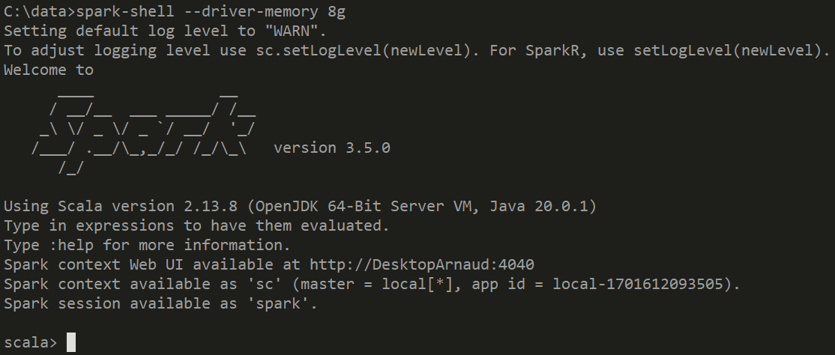
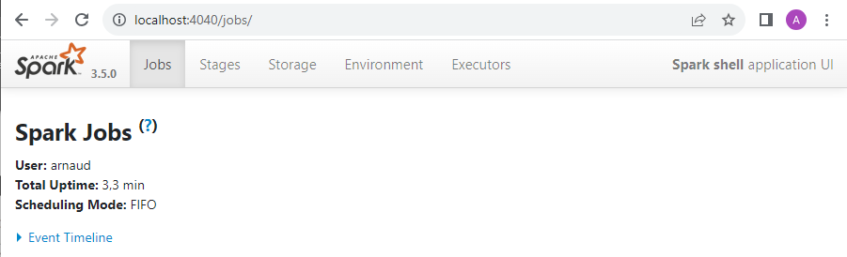
Pre-Requisites
1/ Launch spark-shell
2/ Open Web UI:
spark-shell --driver-memory 8g
http://localhost:4040

Slide 8
Exercise 1: create Table - repartition- insertInto
val ds = spark.createDataset((1 to 1000000).map(x => (s"$x", x % 100)))
// TEST_PART1:
spark.sql("drop table if exists db1.test_part1");
spark.sql("create table db1.test_part1 (col1 string) partitioned by (part1 int) stored as parquet");
ds.repartition(25).write.mode("overwrite").insertInto("db1.test_part1");

Slide 9
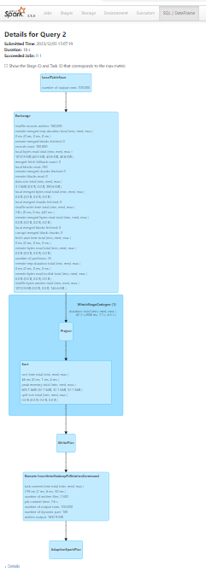
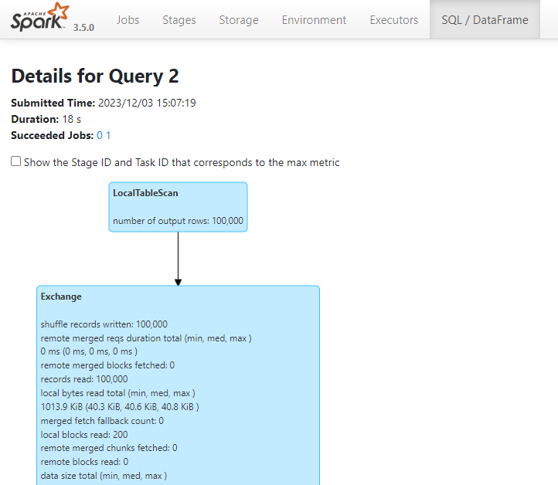
Refresh Spark UI explore all SQL(1/3) > Job > Stages

Slide 10
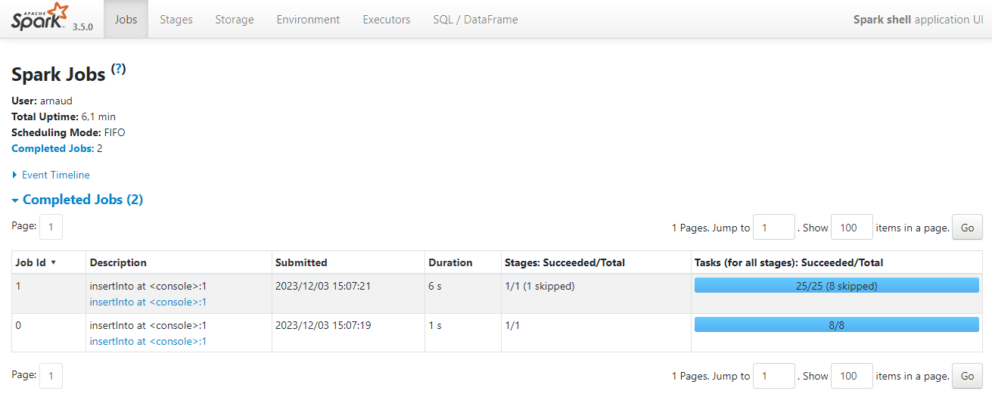
Refresh Spark UI explore all tabs SQL > Jobs(2) > Stages

Slide 11
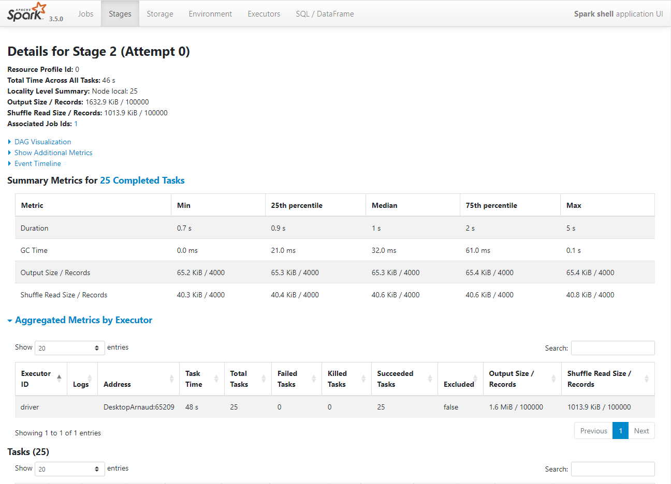
Refresh Spark UI explore all SQL > Jobs > Stages(3/3)

Slide 12
Exercise 1: ... Analysis
1/ explain the directory and files structures of result table
2/ Describe the "insert" action
3/ Explain how Spark executes the action ( how many distinct partition values? how RDD partitions are divided? so how many distinct partition values per RDD partition ? how many jobs / stages / tasks, and side effect of each task ?)
4/ explain (and check on your disk) the number of parquet files written
5/ justify with Spark UI screenshots

Slide 13
Exercise 2: Similar insert, different table
Similar insert, but .repartition(..) by column "_2", instead of .repartition(25)
spark.sql("drop table if exists db1.test_part2");
spark.sql("create table db1.test_part2 (col1 string) partitioned by (part1 int) stored as parquet");
ds.repartition($"_2").write.mode("overwrite").insertInto("db1.test_part2");

Slide 14
Exercise 2: Analysis
1/ explain the directory and files structures of result table
2/ Describe the "insert" action
3/ Explain how Spark executes the action ( how many distinct partition column values? how RDD partitions are divided? so how many distinct partition values per RDD partition ? how many jobs / stages / tasks, and side effect of each task ?)
4/ explain (and check on your disk) the number of parquet files written
5/ justify with Spark UI screenshots

Slide 15
Exercise 3: Similar insert, different table
Similar insert, but .repartition(..) by column "_1", instead of .repartition(25)
emulate an older version of Spark(<3.2 = without the Adaptive Query Execution)
spark.conf.set("spark.sql.adaptive.enabled", "false");
spark.sql("drop table if exists db1.test_part3");
spark.sql("create table db1.test_part3 (col1 string) partitioned by (part1 int) stored as parquet");
ds.repartition($"_1").write.mode("overwrite").insertInto("db1.test_part3");
spark.conf.set("spark.sql.adaptive.enabled", "true")

Slide 16
Exercise 3: Analysis
1/ explain the directory and files structures of result table
2/ Describe the "insert" action
3/ Explain how Spark executes the action ( how many distinct partition column values? how RDD partitions are divided? so how many distinct partition values per RDD partition ? how many jobs / stages / tasks, and side effect of each task ?)
4/ explain (and check on your disk) the number of parquet files written
5/ justify with Spark UI screenshots

Slide 17
Exercise 4: Similar insert, different table ( Advanced: Adaptive Query Execution !)
Similar insert, but .repartition(..) by column "_1"
using a recent version of Spark (>=3.2 = with AQE optim)
spark.sql("drop table if exists db1.test_part4");
spark.sql("create table db1.test_part4 (col1 string) partitioned by (part1 int) stored as parquet");
ds.repartition($"_1").write.mode("overwrite").insertInto("db1.test_part4");

Slide 18
Exercise 4: Analysis
1/ explain the directory and files structures of result table
2/ Describe the "insert" action
3/ Explain how Spark executes the action ( how many distinct partition column values? how partitions are divided? What did Spark to detect & fix abnormal usage of partitions like in Exercise 3/ ? how many jobs / stages / tasks, and side effect of each task ?)
4/ explain (and check on your disk) the number of parquet files written
5/ justify with Spark UI screenshots

Slide 19
Exercise 5
For execution of exercise 4/, compare and explain
a/ the spark API code to create linked Dataset objects that depends of each others
b/ the DAG view of the Logical Plan in Spark UI tab "Sql"
c/ the ascii printed version of the Plan (Logical or Physical)
you can obtain it by clicking on on bottom of SQL tab
d/ the DAG view of Job-Stage in Spark UI tab "Jobs"
Do drawings explaining how Spark goes from a/ to b/ (or c/), then from b/ to d/

Slide 20
Let's switch to use Spark UI for "SELECT" queries
We will study the optimization Plan on File reads
(Partition pruning, Predicate-Push-Down)
We will reuse the dataset (and tables) on the OpenData.gouv "BAL addresses"

Slide 21
Exercise 6: Query Partitioned Table WHERE partitionColumn=..
a/ remind on previous Hands-On TD3 SHOW CREATE TABLE db1.address => .. Un-partitioned table, PARQUET
SHOW CREATE TABLE db1.address_by_dept => .. Partitioned table, PARQUET
b/ execute queries SELECT * FROM address_by_dept WHERE dept=92
SELECT * FROM address_by_dept WHERE dept in (75,78,91,92)
SELECT * FROM address_by_dept WHERE commune_name = ‘Nanterre’
c/ Remind which dir / files should be read by spark… which query is faster

Slide 22
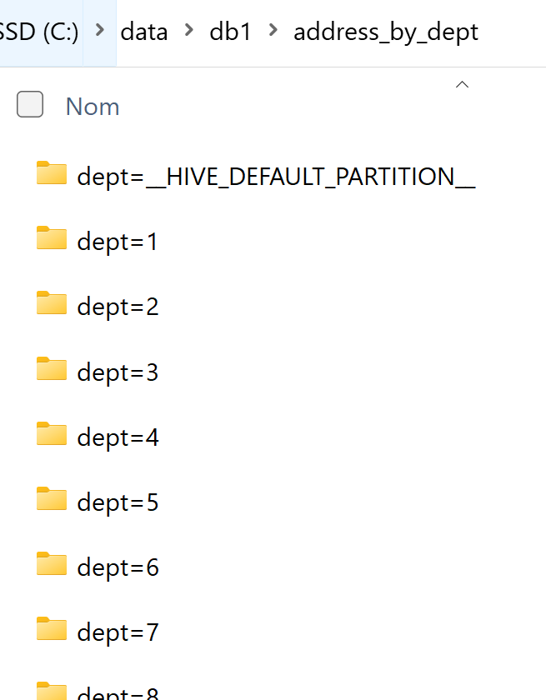
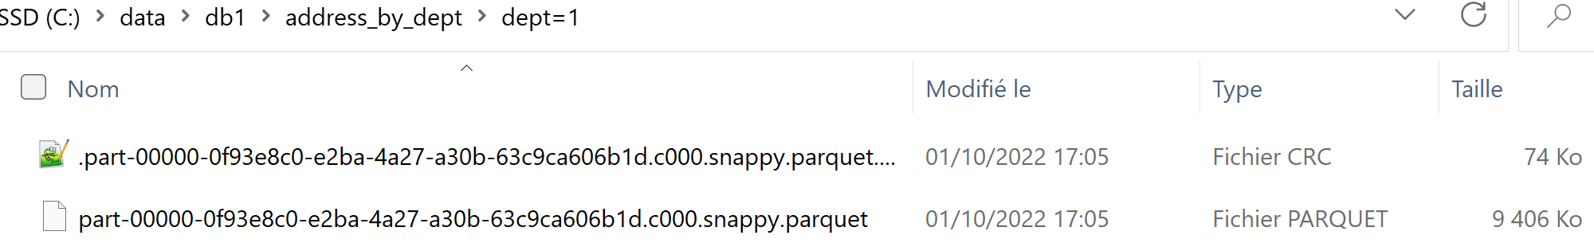
Reminder Exercise 6 : Directory /partCol=value/* data files do not contain « partCol »

Slide 23
Exercise 7: Execute « EXPLAIN <<SQL>> »
a/ Execute SQL… prefixed by “EXPLAIN” keyword
spark.sql("EXPLAIN select count(*) FROM db1.address_by_dept WHERE dept=92")
Hint: display nicely, using .show(false) OR .foreach(println(_))
b/ do you see “PartitionFilters: [ ..]” ?

Slide 24
Exercise 7(next): using dataset.explain() API
val ds = spark.sql("select count(*) FROM db1.address_by_dept WHERE dept=92") ds.explain
ds.explain(false)
ds.explain(true)

Slide 25
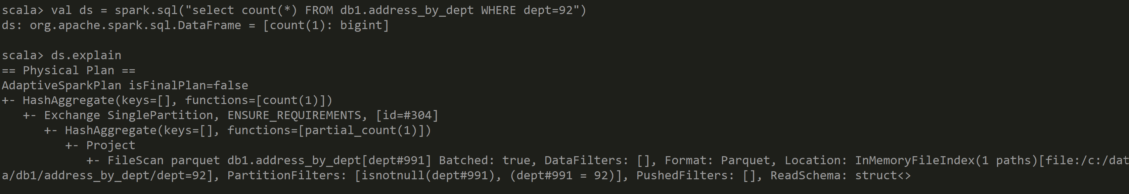
Answer Exercise 7: Dataset.explain

Slide 26
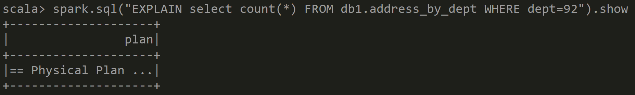
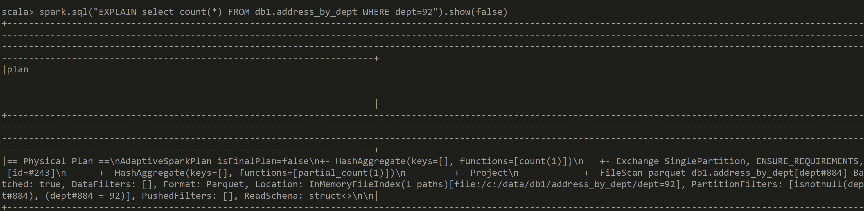
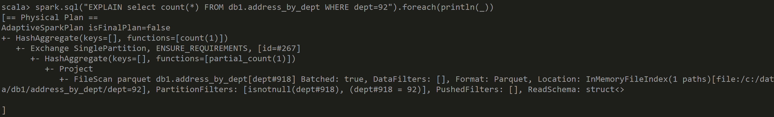
Answer Exercise 6: SQL Explain Plan

Slide 27
Exercise 8 : compare « EXPLAIN » queries
a/ Compare both
spark.sql("EXPLAIN select count(*) FROM db1.address_by_dept WHERE dept=92")
spark.sql("EXPLAIN select count(*) FROM db1.address WHERE dept=92")
b/ what changed ?

Slide 28
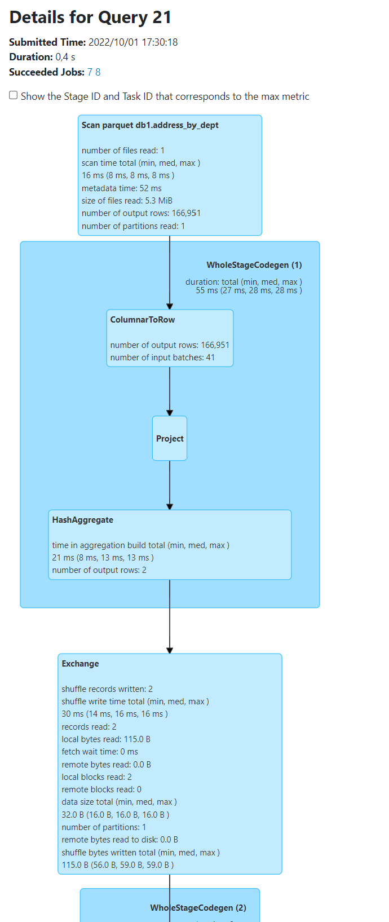
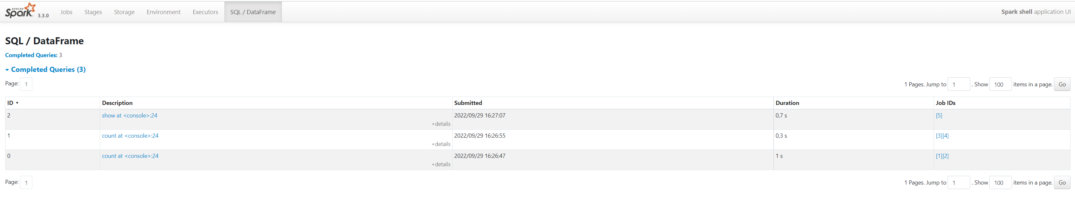
Answer Exercise

Slide 29
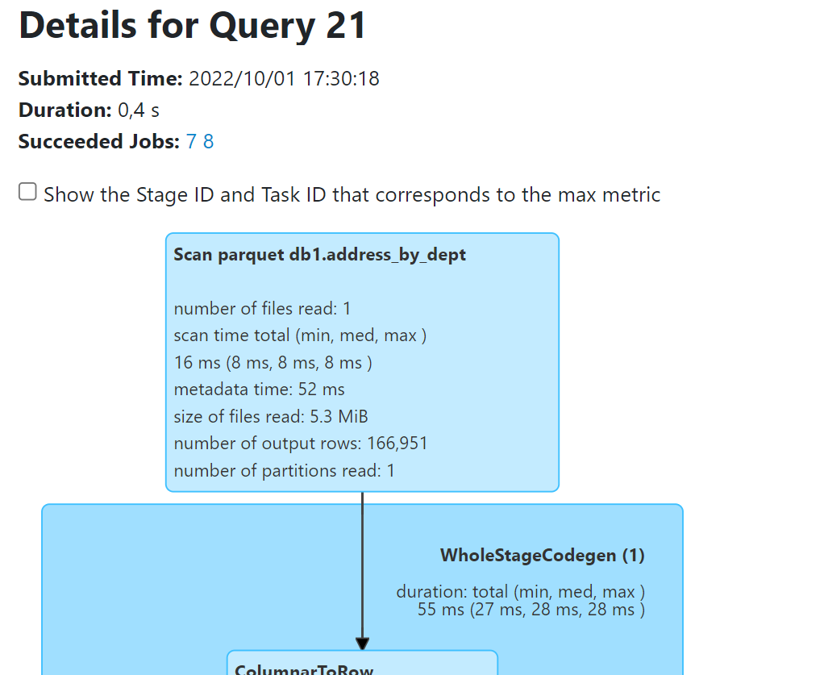
Partition Pruning … FirstClue: Only 1 File Read
Number of files read: 1 … was 1 file per partition
Number of partitions read: 1

Slide 30
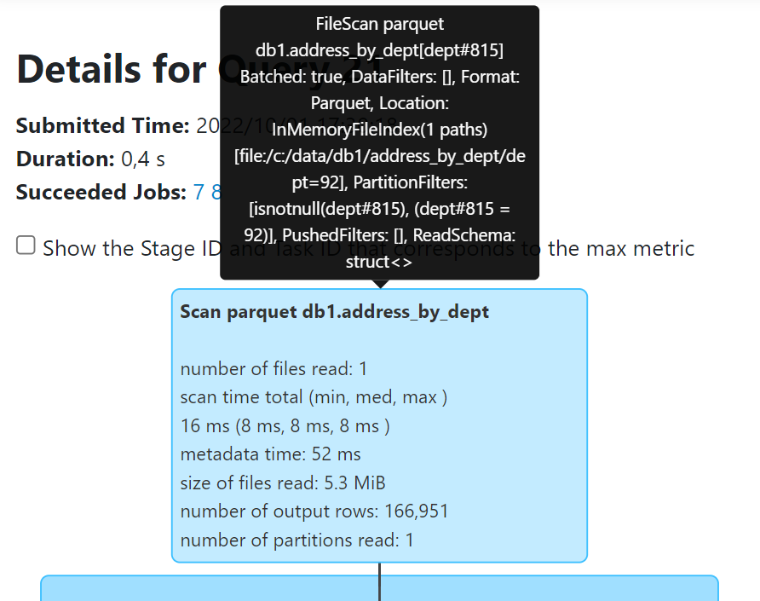
… Search « PartitionFilters » in Explain Plan
PartitionFilters: [
isnotnull(dept#815),
dept#815 = 92
]
Move mouse over .. Show tooltip

Slide 31
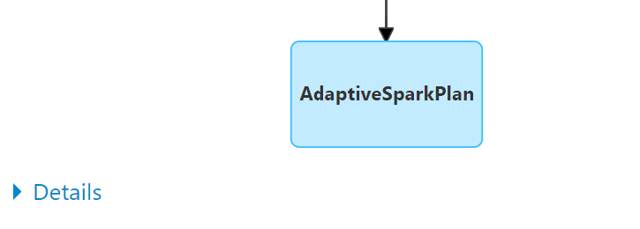
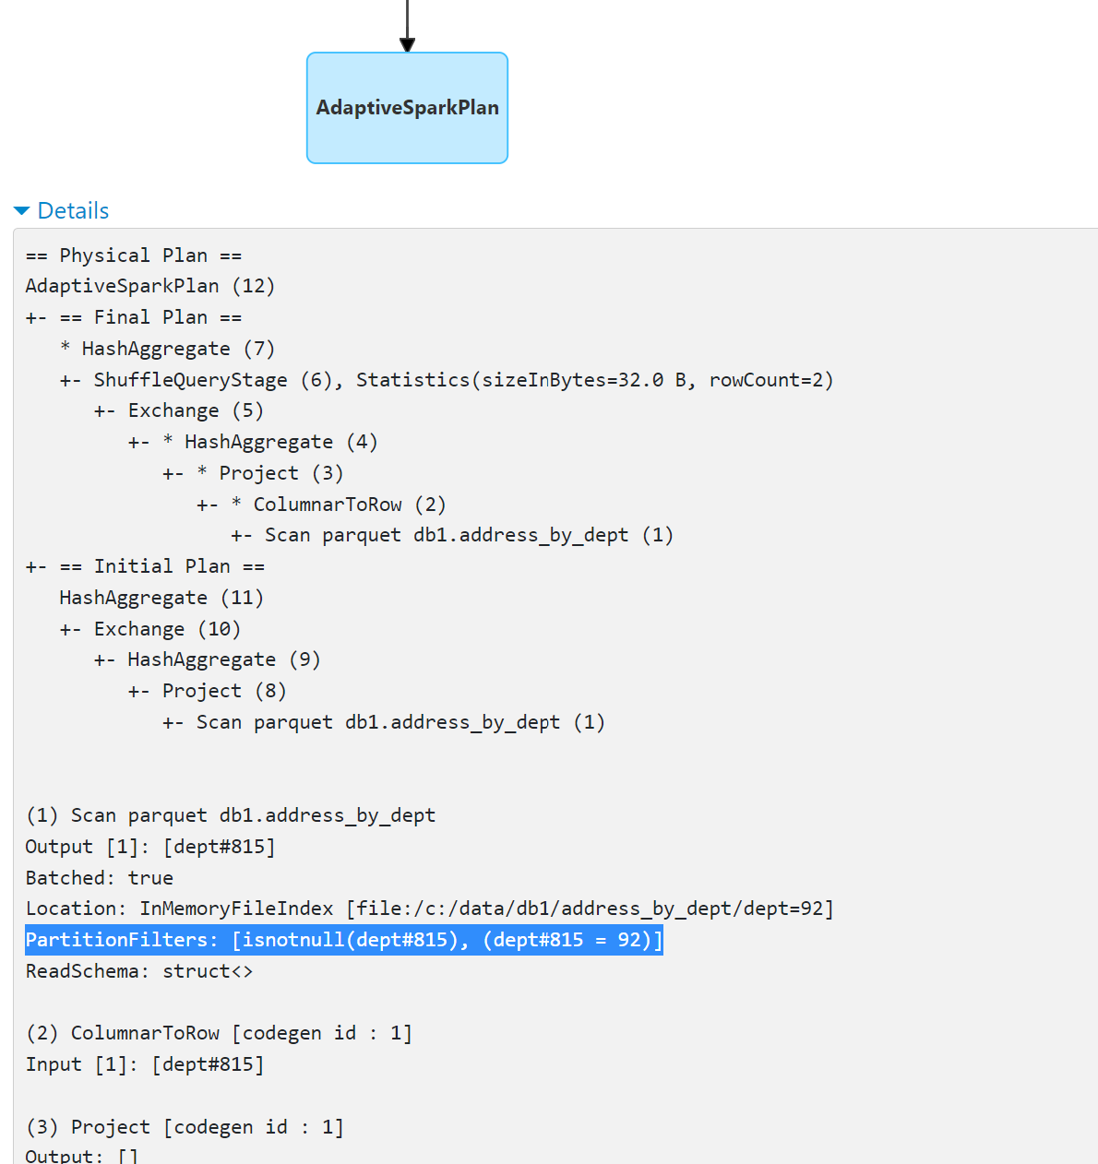
… Search PartitionFilters:[..] in textual « Details »
Click Details
Expanded

Slide 32
Exercise 9 : dataset parralelism (N partitions) => show N tasks in Job->Stage->Tasks
a/ browse from SQL logical plan to execution plan: Jobs->Stages
b/ take SparkUI screenshot showing detailed table results (time, IO statistics) PER partition.
c/ Check table results has N rows, where N=ds.toJavaRDD.getNumPartition Is the dataset well balanced (or skewed) ?
d/ take screenshot of (min-average-max) partition results in DAG

Slide 33
Objectives of Hands-On
1/ Execution Plan, SQL Explain / dataset.explain
2/ Spark UI, DAG,
Narrow/Wide Transformations
3/ RDD cache / checkpoint
4/ Partition Pruning / Columns Pruning / Predicate-Push-Down
5/ Parquet Optims ( Sort, Stats, Dictionary, Bloom, BlockSize)
6/ perfs: SpillToDisk, JOINs, hint

Slide 34
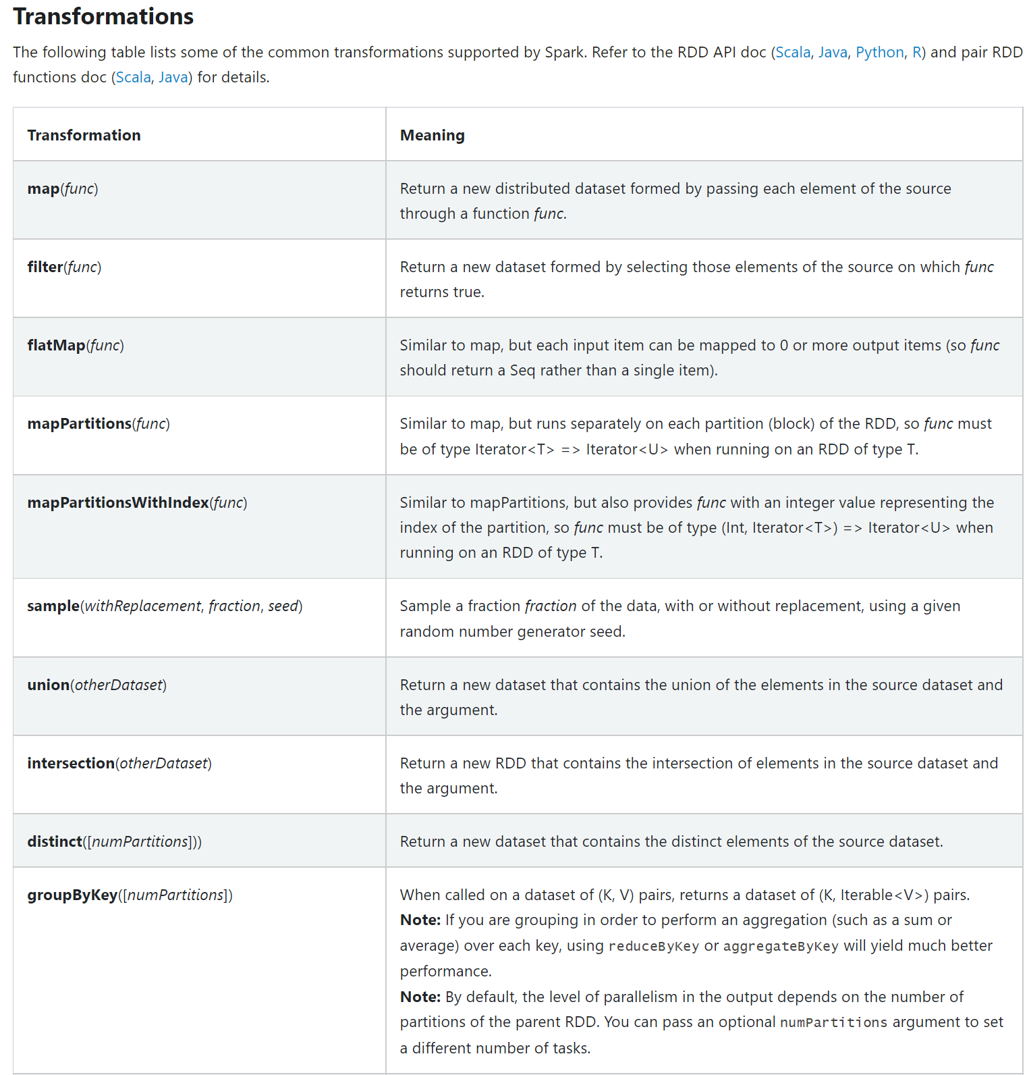
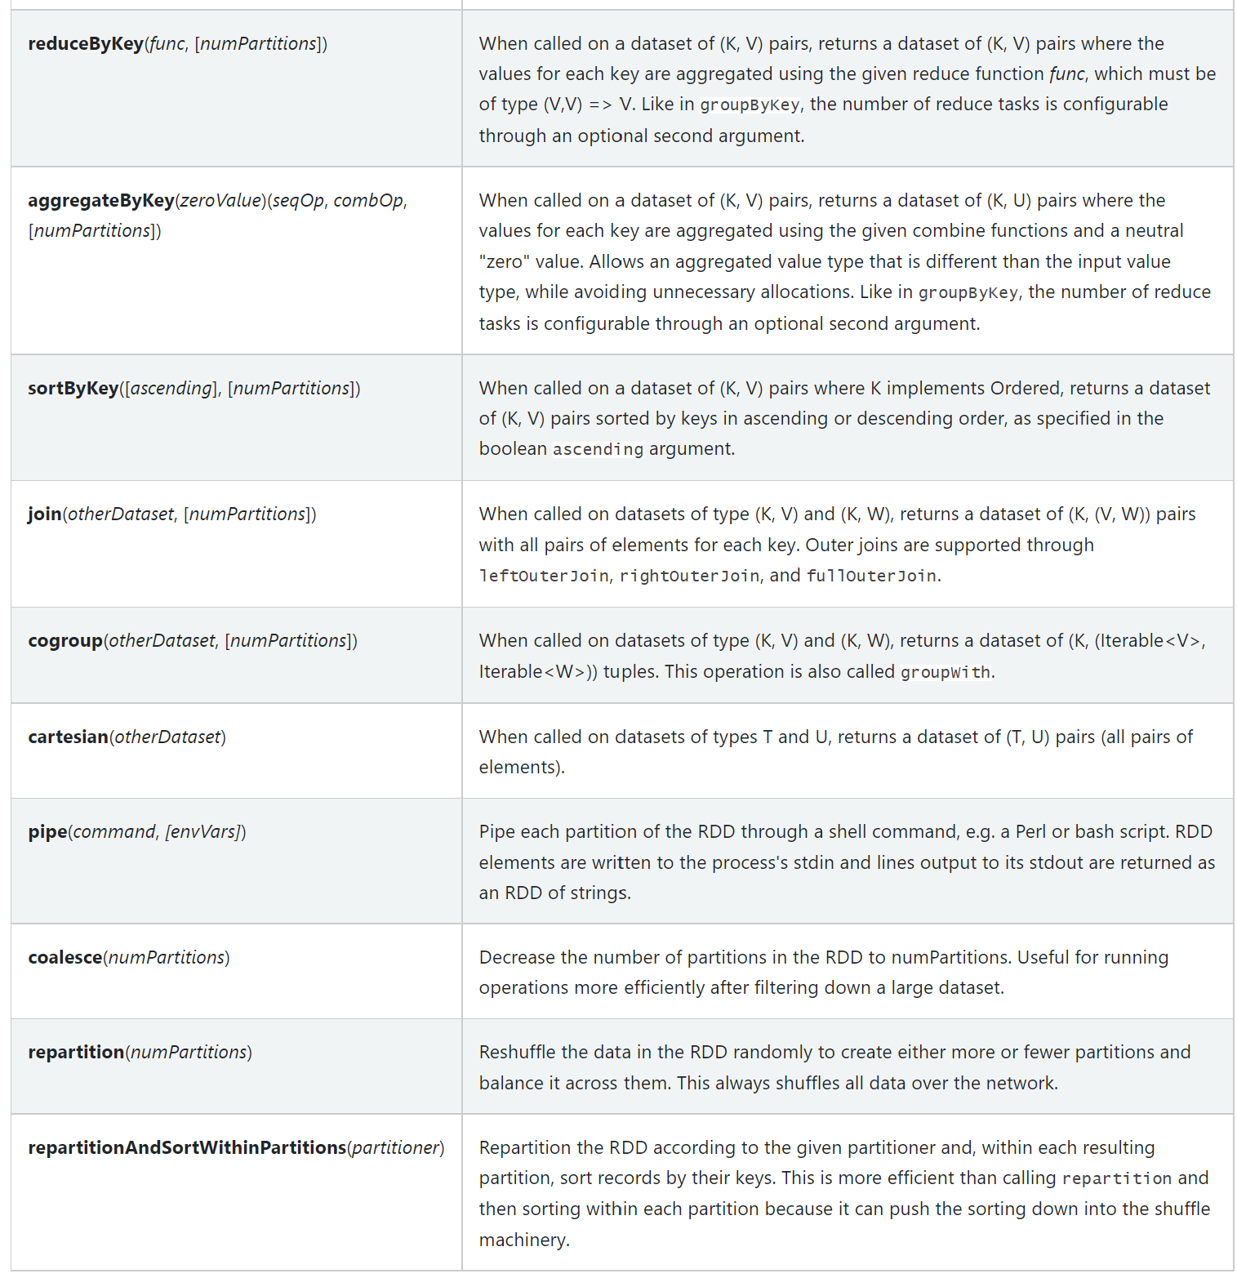
Reminder: Narrow/Wide Transformations
https://spark.apache.org/docs/latest/rdd-programming-guide.html#transformations

Slide 35
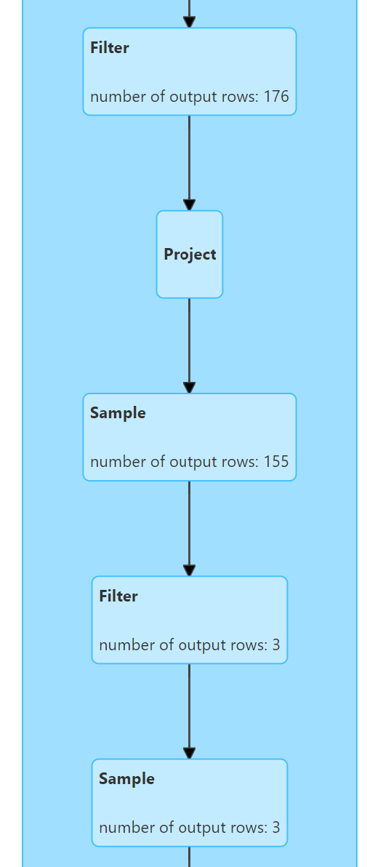
Exercise 10: combine several Narrow transformations filter, sample, select, withColumn …
a/ Execute query like
val addressDs = ….. .filter(a).filter(b) // => check Spark combine as .filter(a && b) !!
b/ ..like
addressDs .withColumn(..)
.filter( .. ) .sample(0.9)
.filter( .. ) .sample (0.9) .count
b/ Check in Spark UI that there is only 1 « WholeStageCodegen (1) » containing several instructions

Slide 36
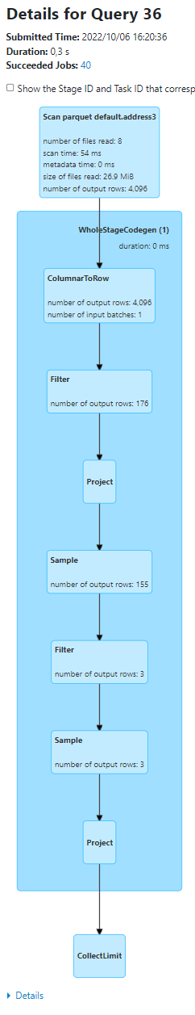
Answer Exercise 10:
Example spark.sql("select * from address3") .filter("commune_nom like '%n%’ »)
.withColumn("commune_nom2", col("commune_nom")) .filter("commune_nom2 like '%a%’ »)
.withColumn("commune_nom3", concat(col("commune_nom2"), lit("X")))
.sample(0.9)
.filter("commune_nom3 like '%t%’ »)
.sample(0.9)
.show(2, false)

Slide 37
Exercise 11: WholeStageCodegen java code for(;;) on Dataset<Row>…
a/ Show the corresponding generated Java Code of WholeStageCodegen
use ds.queryExecution.debug.codegen
b/ read it … find « .. extends org.apache.spark.sql.execution.BufferedRowIterator »
c/ find method @Override protected void processNext() { .. It is supposed to map copy all filtered rows x columns to new RDD[Row]
d/ do you find your filter conditions on your columns ?
https://github.com/apache/spark/blob/master/sql/core/src/main/java/org/apache/spark/sql/execution/BufferedRowIterator.java#L97

Slide 38
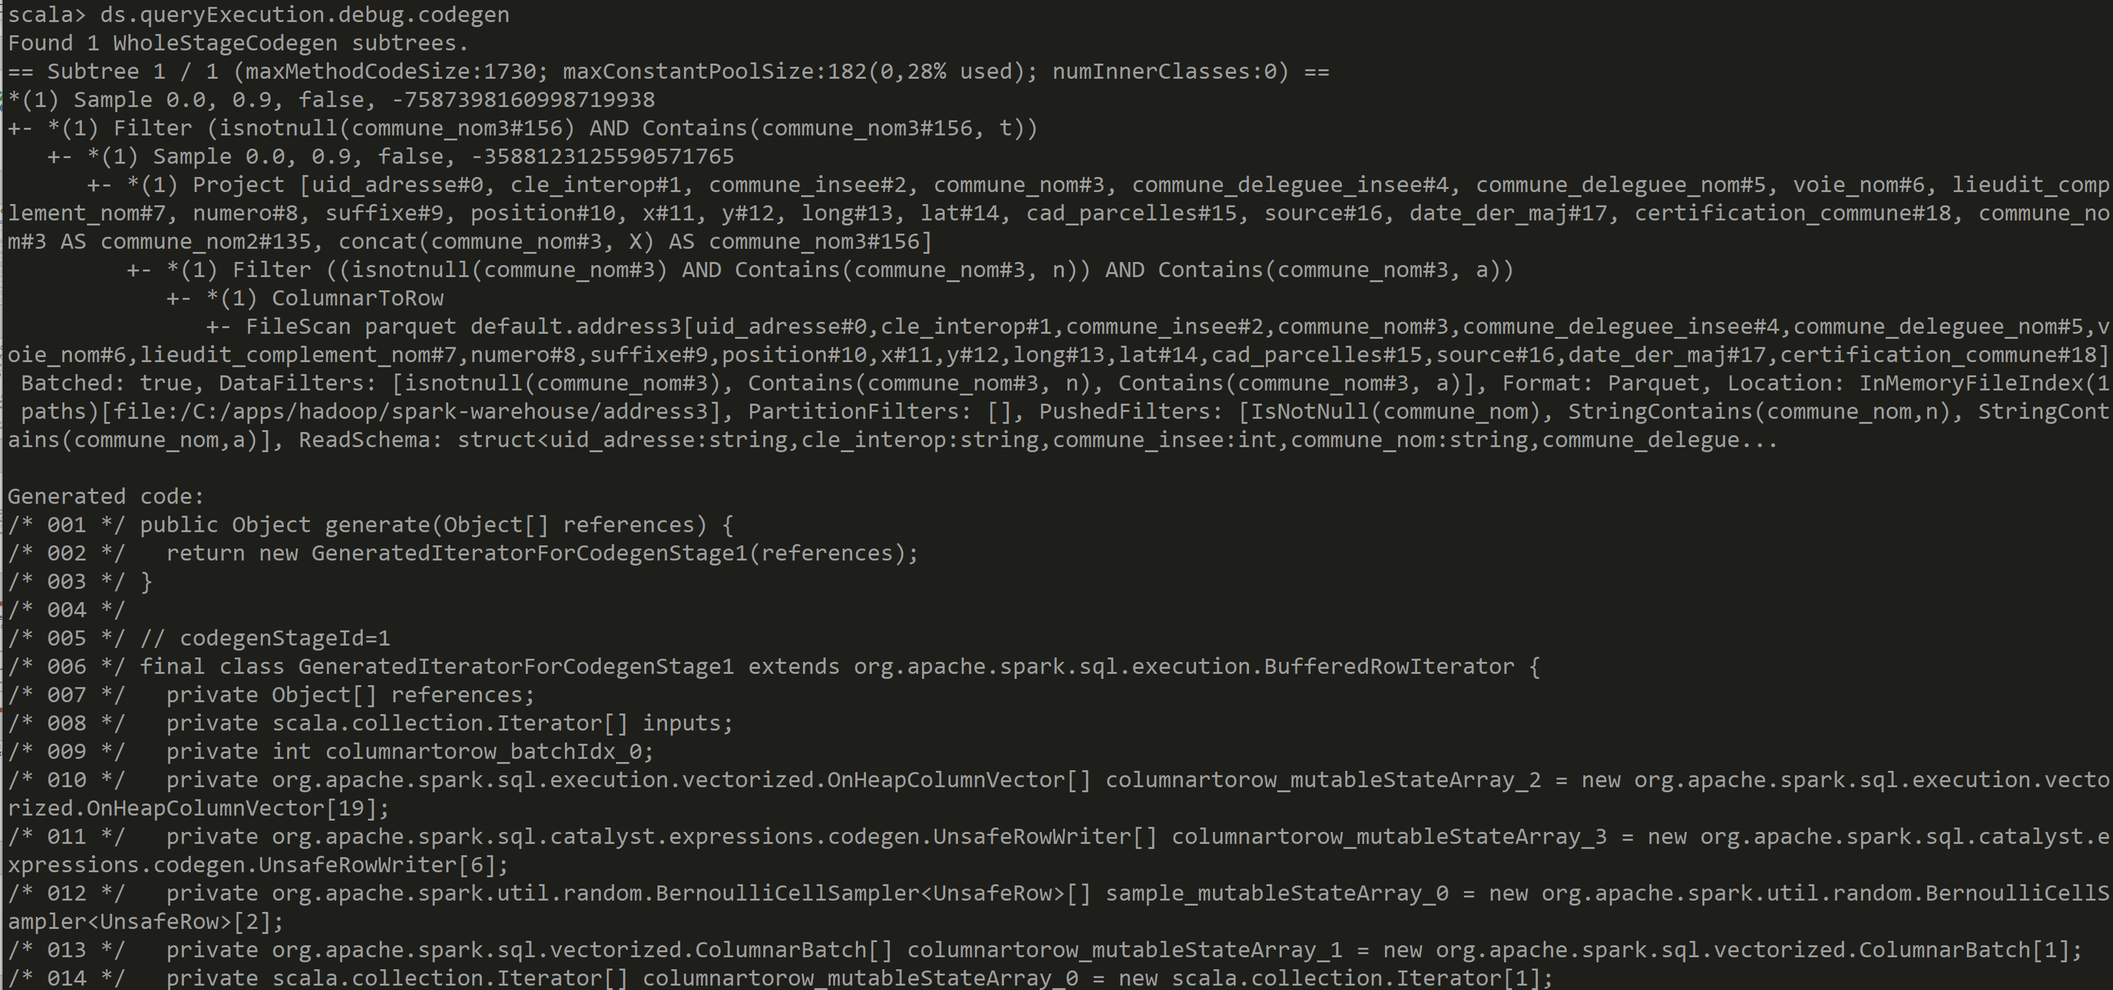
Answer Exercise

Slide 39
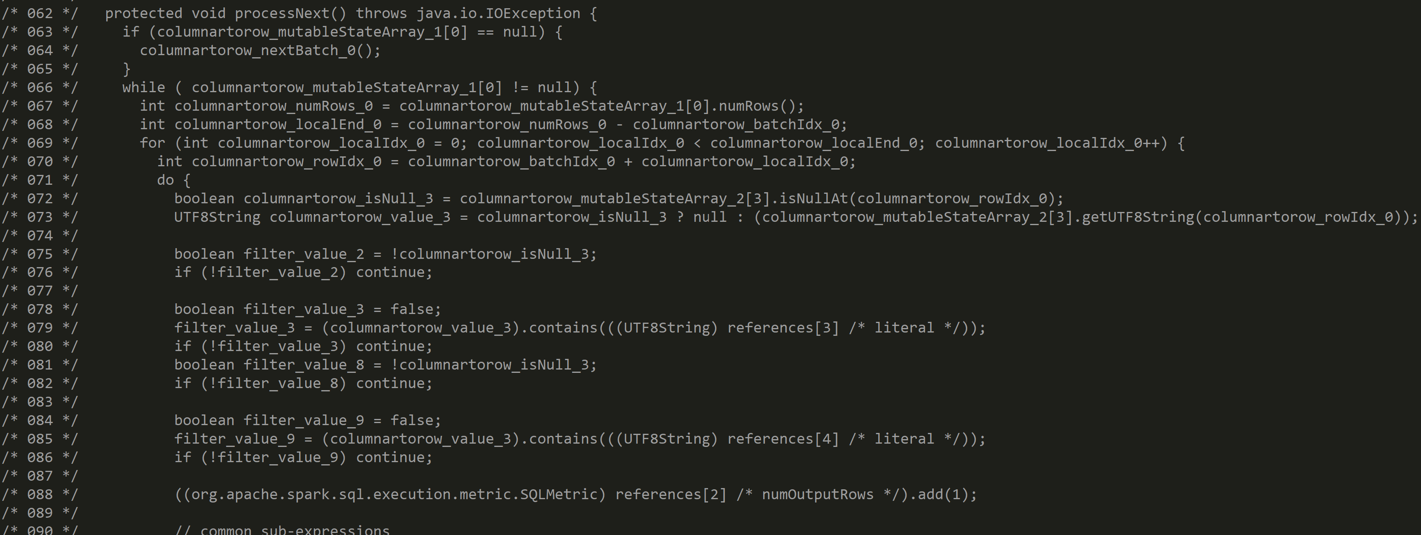
Answer Exercise

Slide 40
Exercise 12: cascade several Wide Transformations: repartition, groupByKey, join, distinct..
a/ Execute query like
addressDs .repartition(3)
.repartition(2, $"commune_insee")
.repartition(4)
.repartition(2, $"commune_nom")
.count
b/ Check in Spark UI that there are N shuffles

Slide 41
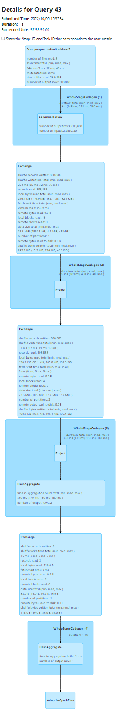
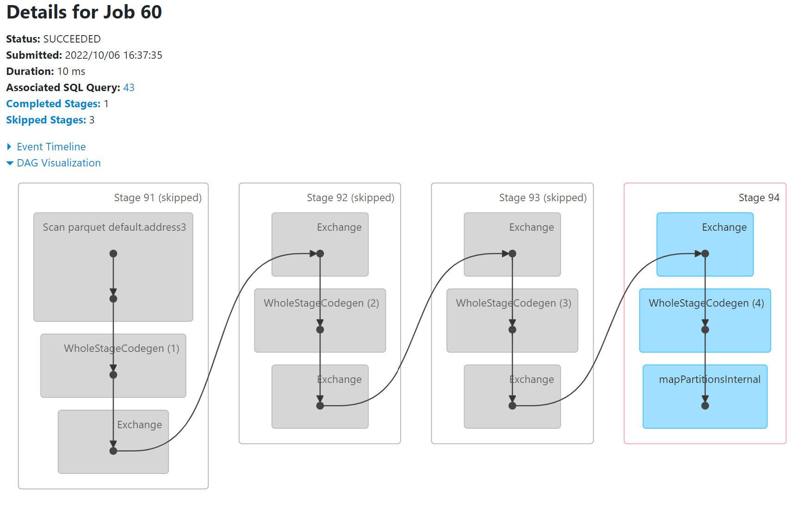
Answer Exercise

Slide 42
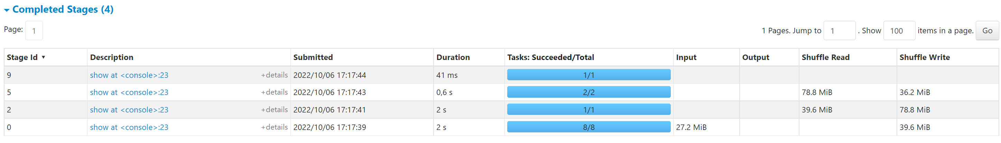
Exercise 13: Check on 2 consecutive Stages that previous Shuffle Write = next Shuffle Read

Slide 43
Exercise 14: mix cascade of Narrow and Wide
Example
spark.sql("select * from address3")
.repartition(1).sample(0.9) .repartition(2).sample(0.8).filter("commune_nom like '%a%'")
.repartition(3).sample(0.7).filter("commune_nom like '%t%'").sample(0.6)
.count
a/ Explain how many Shuffles you expect
b/ How many instructions you expect in each WholeStageCodegen (1), WholeStageCodegen (2), WholeStageCodegen (3)

Slide 44
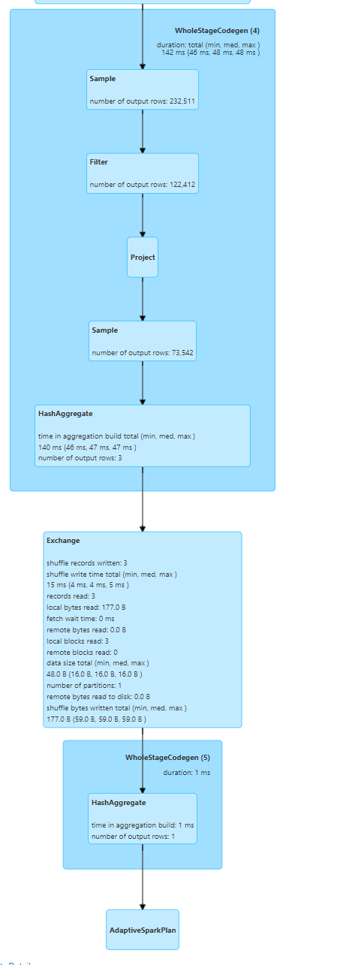
Answer Exercise 14
spark.sql("select * from address3")
.repartition(1) // wide
.sample(0.9) .repartition(2) // wide
.sample(0.8)
.filter("commune_nom like '%a%’ »)
.repartition(3) // wide
.sample(0.7)
.filter("commune_nom like '%t%’ »)
.sample(0.6)
.count

Slide 45
Objectives of Hands-On
1/ Execution Plan, SQL Explain / dataset.explain
2/ Spark UI, DAG, Narrow/Wide Transformations
3/ RDD cache / checkpoint
4/ Partition Pruning / Columns Pruning / Predicate-Push-Down
5/ Parquet Optims ( Sort, Stats, Dictionary, Bloom, BlockSize)
6/ perfs: SpillToDisk, JOINs, hint

Slide 46
Exercise 15: Several Actions on same Dataset
a/ Execute several actions on same Dataset ds.show
ds.show
b/ equivalently… several SQL
select * from address
select * from address
b/ Check in SparkUI that ds is recomputed each time (show screenshots with job ids, stage ids)
c/ Check Spark File IO Statistics, Shuffle, Time elapsed

Slide 47
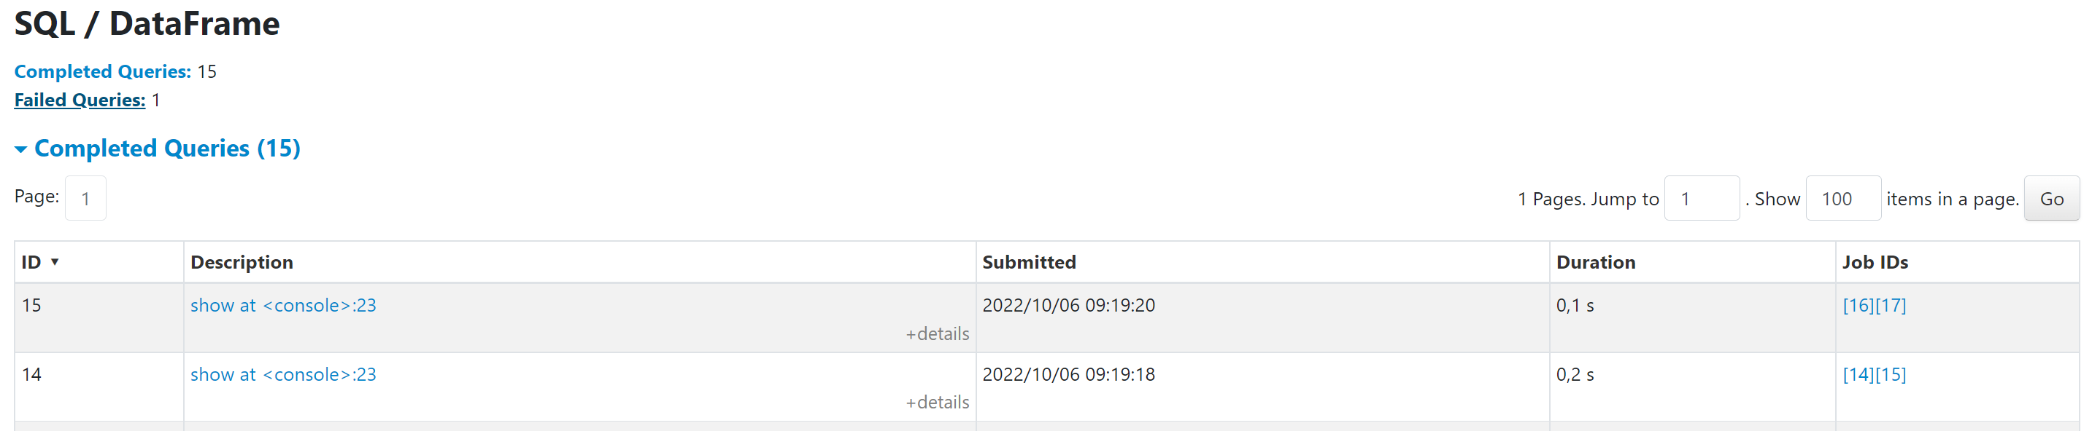
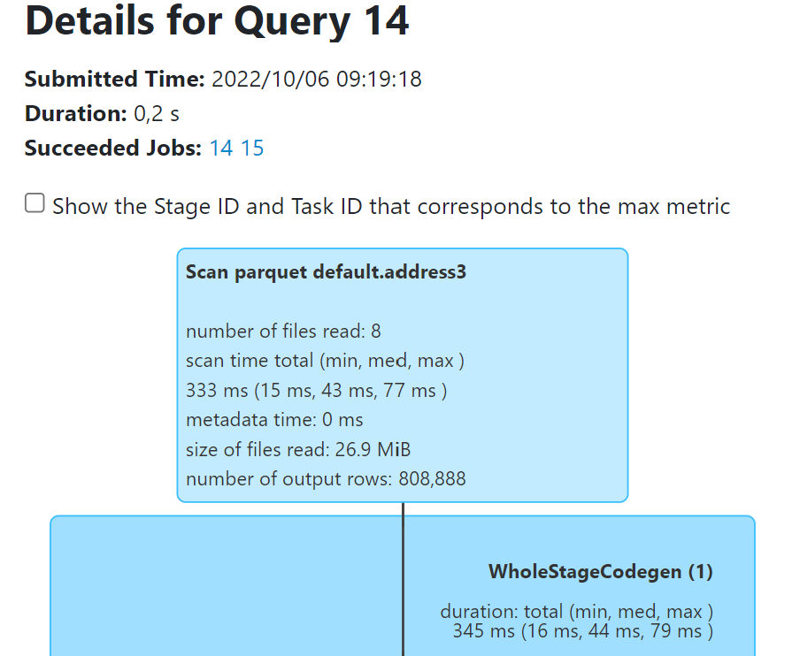
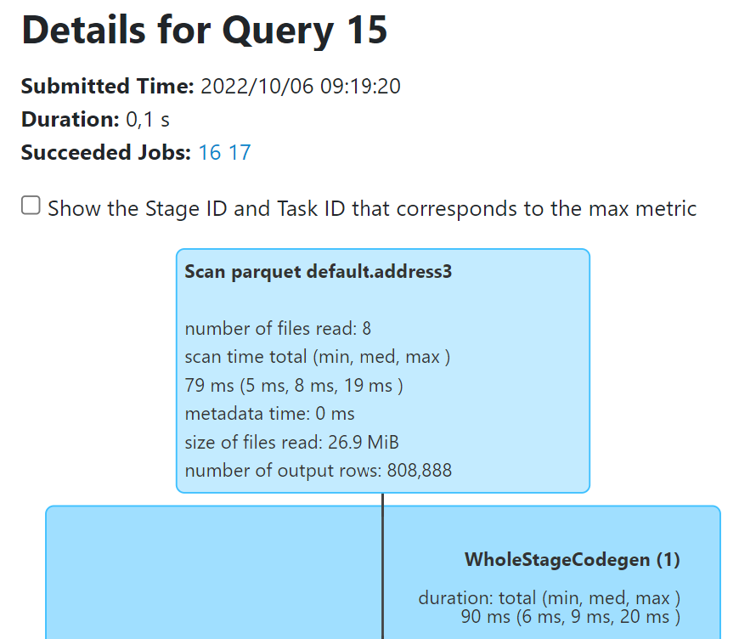
Answer Exercise 15:
Repeated
query
Similar
Files Read Count,
Bytes Read, Rows Count..
Different JobId, Times elapsedMillis

Slide 48
Exercise 16: Avoiding re-computation dataset .cache()
a/ Same as Exercise 12… but use before
ds.cache() // or equivalent: .persist()
Execute several actions on cached Dataset ds.show
ds.show
b/ Check in SparkUI that ds is NOT recomputed
… But Full lineage is still displayed several time in greyed / with green point
give screenshots showing job ids / stage ids
c/ check in SparkUI > Storage > RDD
d/ and after … ds.unpersist()

Slide 49
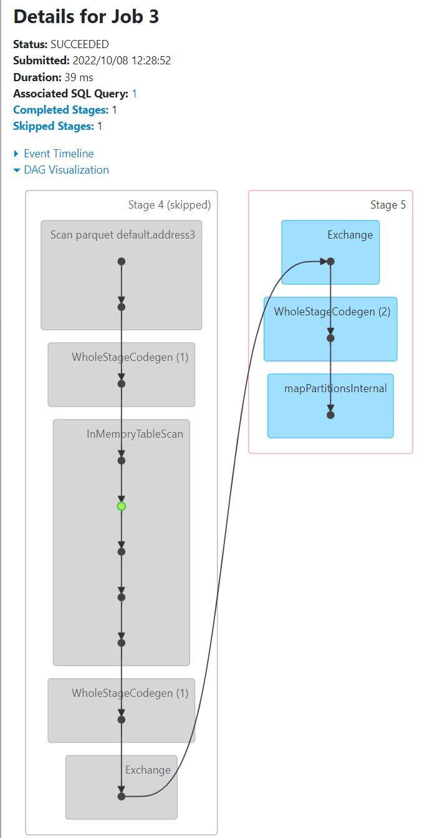
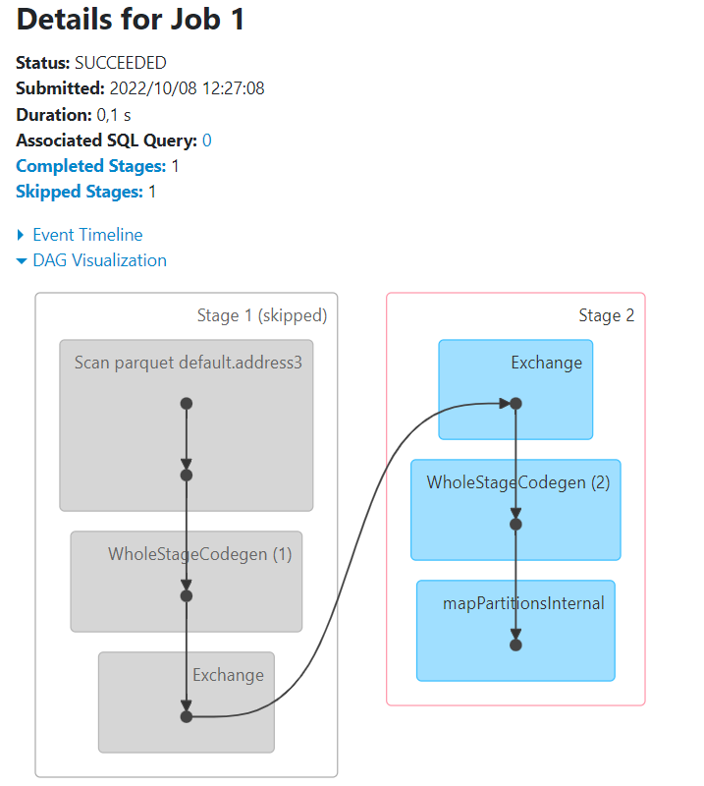
Answer Exercise 16: .cache() / .unpersist()
First Execute:
val ds = spark.sql("select * from address3") .filter("commune_nom like '%a%'")
ds.count
ds.cache
ds.count
ds.count
Ds.unpersist
ds.count
Same as 2.. Skipper Scan + filter
Same as 1.. Skipper Scan + filter
green point

Slide 50
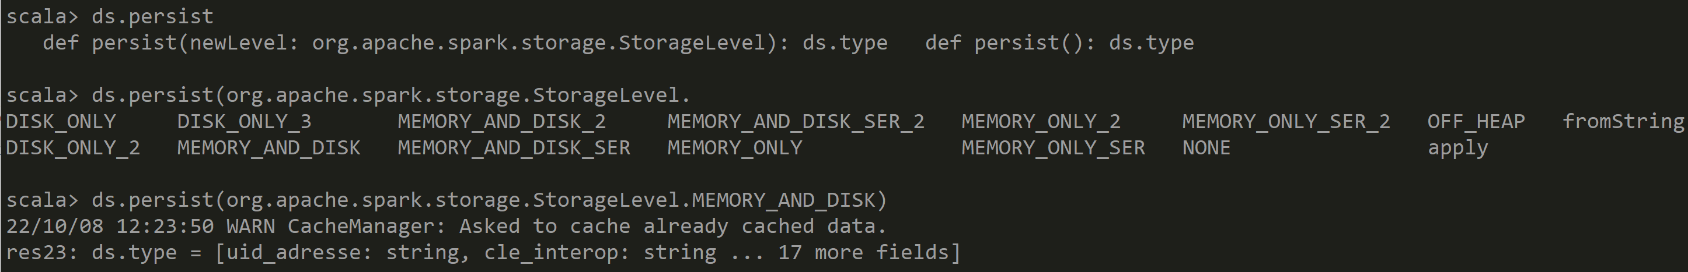
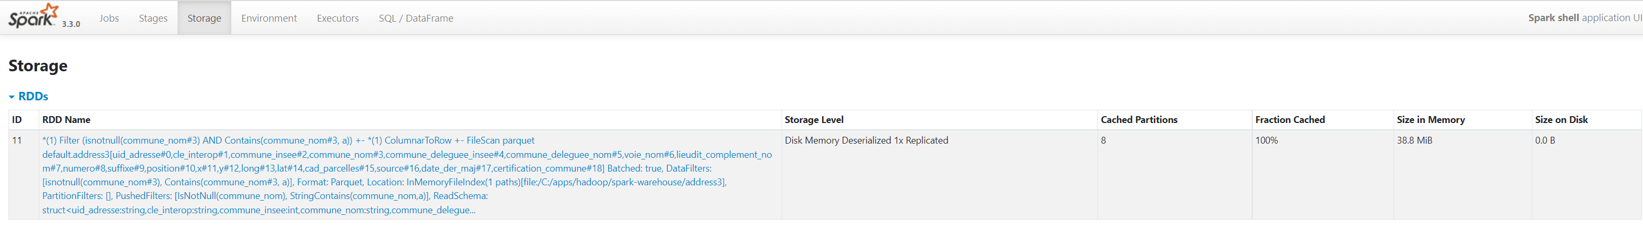
Answer Exercise

Slide 51
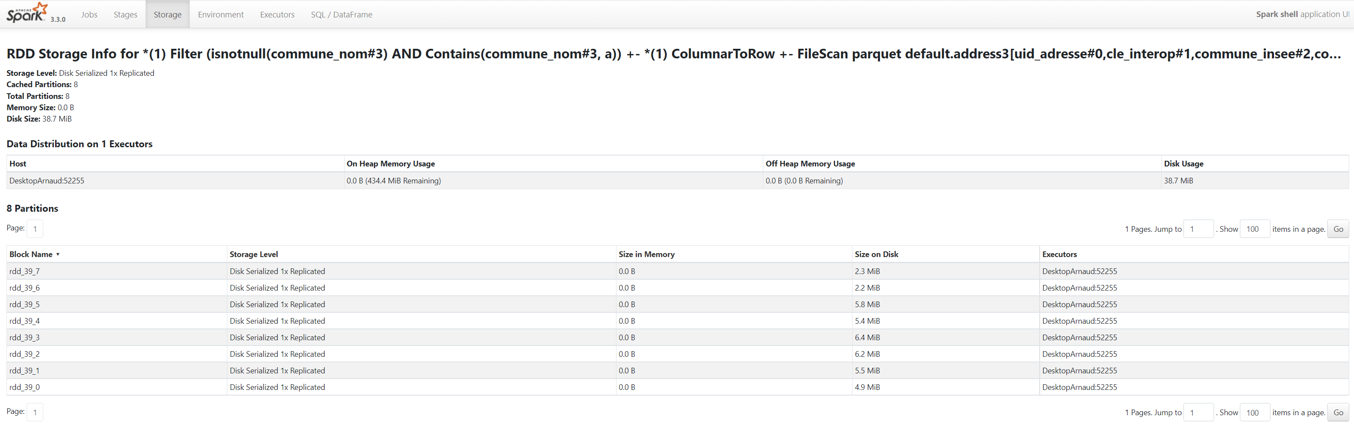
Anser Exercise: persist(DISK_ONLY)
Files Location … System.getProperty("java.io.tmpdir")
Example: C:\Users\arnaud\AppData\Local\Temp\blockmgr-a862d926-8354-44e4-b7c8-4676264742ea\37\rdd_39_5

Slide 52
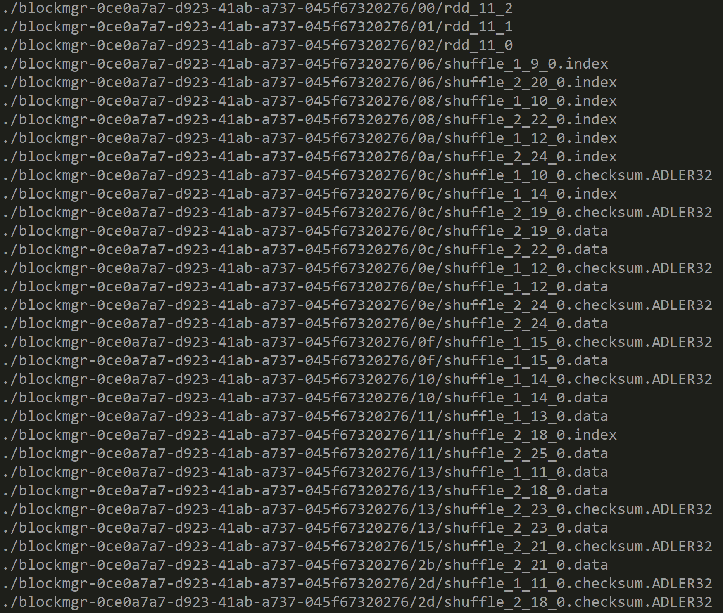
Answer Exercise: Files location for RDD and shuffles

Slide 53
Exercise 17: Execute complex DAG on dataset with lot of duplicates
Example: dataset repeated, with small variations, then union …
val ds1 = spark.sql("select * from address3").repartition(2).filter("commune_nom like '%n%'").repartition(2).sample(0.9);
val ds2 = ds1.union(ds1).limit(1000).repartition(2).sample(0.9);
val ds3 = ds2.union(ds2).limit(1000).repartition(2).sample(0.9).union(ds2);
val ds4 = ds3.union(ds3).limit(1000).repartition(2).sample(0.9).union(ds3);
val ds5 = ds4.union(ds4).limit(1000).repartition(2).sample(0.9).union(ds3);
ds5.count;
Open corresponding DAG in Spark UI

Slide 54
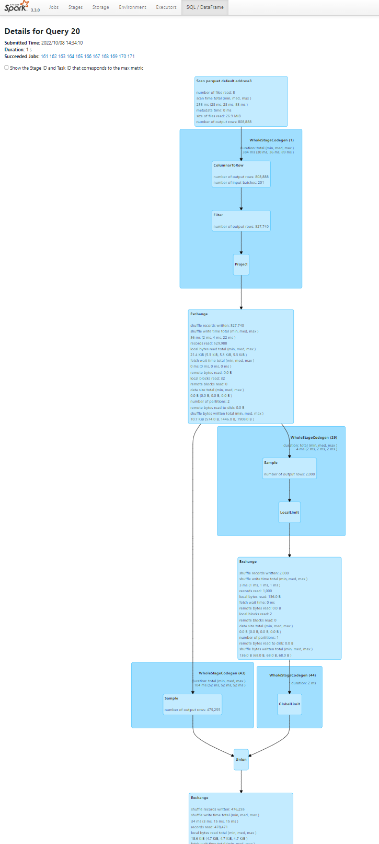
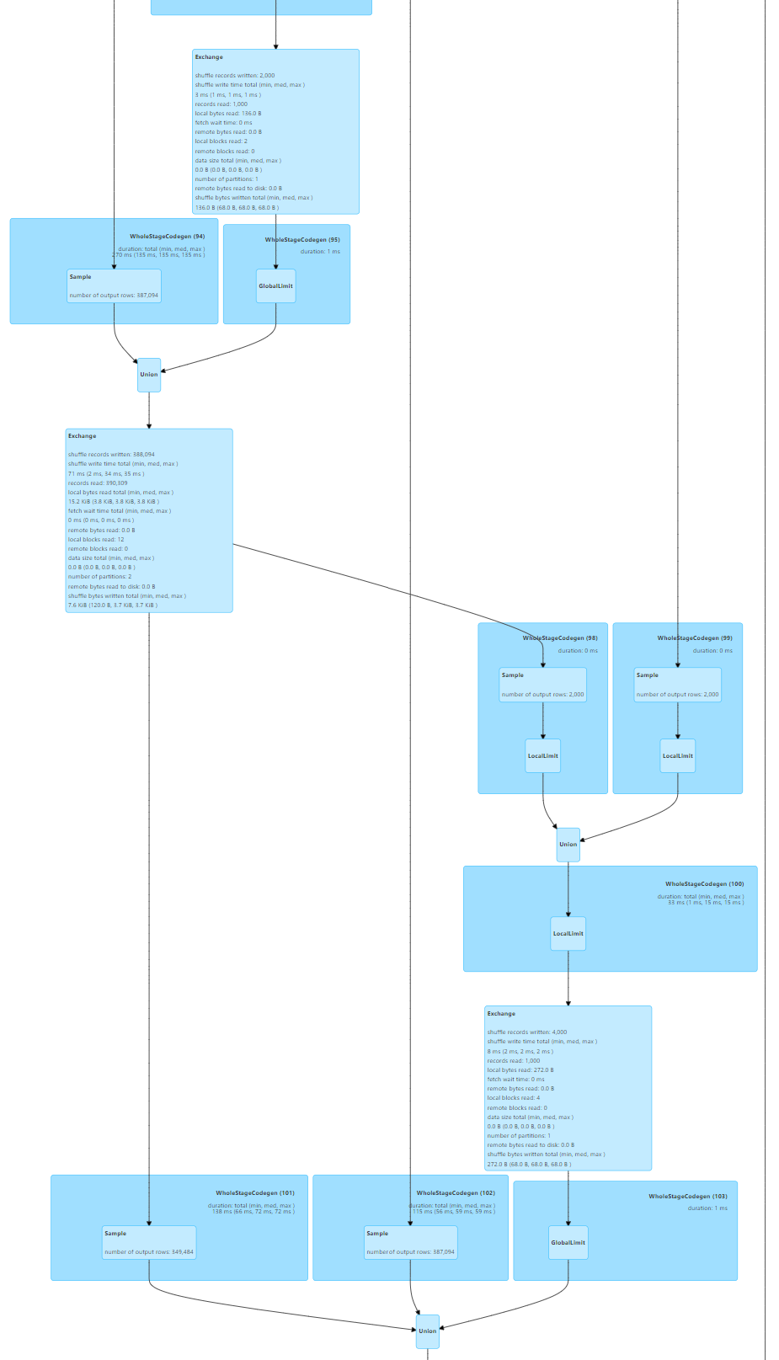
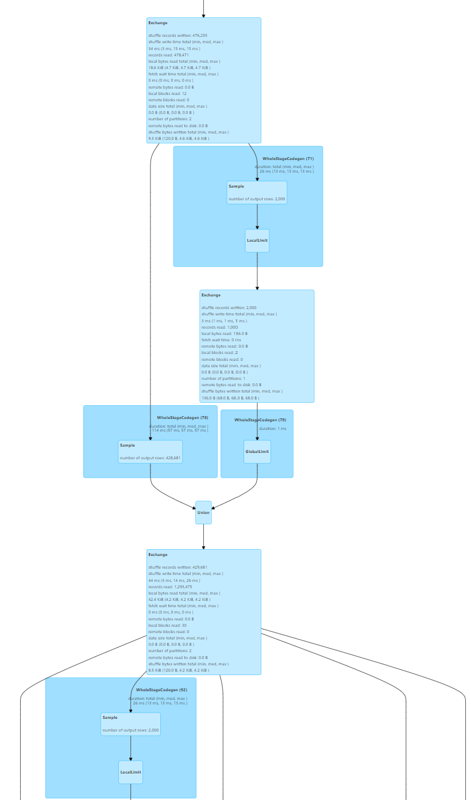
Answer Exercise 17: Read SparkUI DAG
And More..
(not shown)

Slide 55
Exercise 18: How to simplify DAG display ? … .checkpoint() !
a/ ensure
sc.setCheckpointDir(« c:/data/checkpoint-dir »)
b/ Same as Exercise 15… but use checkpoint:
ds3Before=.. val ds3 = ds3Before.checkpoint(); // IMPORTANT TO RE-ASSIGN and use new
ds4=..
c/ Check in SparkUI that ds3 is persisted,
… AND lineage no more displayed
d/ there is NO « unCheckpoint() » as there is for unpersist()

Slide 56
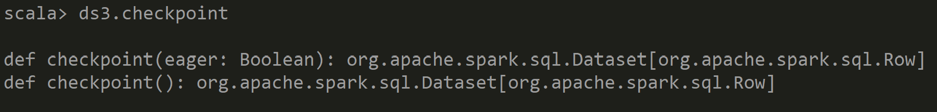
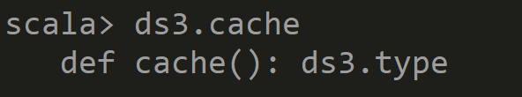
Exercise 18: .. Checkpoint directory has not been set in the SparkContext
sc.setCheckpointDir(« c:/data/checkpoint-dir »)
Signature: Dataset.checkpoint() ➔ return NEW Dataset !!
Different signature for .cache() !! No need to reassign

Slide 57
Exercise 18: checkpoint -> new Dataset
Signature: Dataset.checkpoint() ➔ return NEW Dataset !!
Different signature for .cache() !! No need to reassign
When checkpoint Files will be deleted ??
There is a flag … spark.cleaner.referenceTracking.cleanCheckpoint .. But Default to false
Checkpoint main usage is for Spark Streaming.. NOT DAG Optim

Slide 58
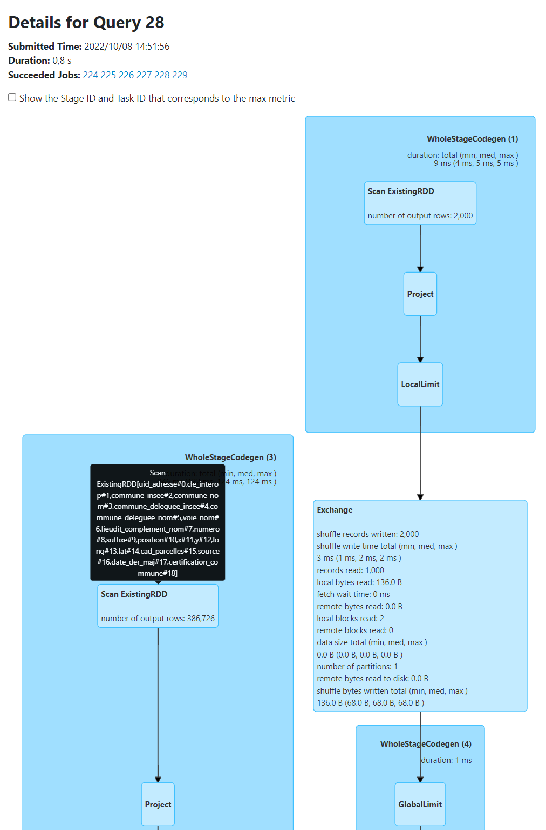
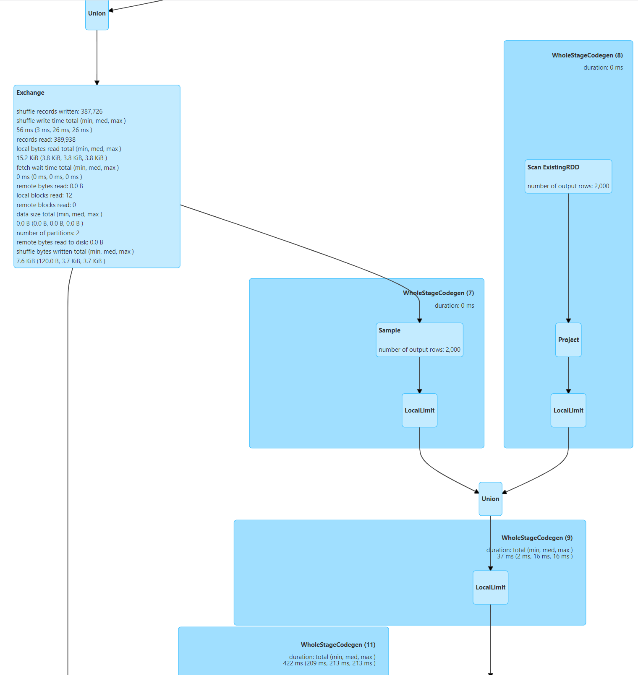
Answer Exercise: DAG with checkpoint
DS3..
DS3… inlined as
« Scan Existing RDD »
And More..
(not shown)

Slide 59
Objectives of Hands-On
1/ Execution Plan, SQL Explain / dataset.explain
2/ Spark UI, DAG, Narrow/Wide Transformations
3/ RDD cache / checkpoint
4/ Partition Pruning / Columns Pruning / Predicate-Push-Down
5/ Parquet Optims ( Sort, Stats, Dictionary, Bloom, BlockSize)
6/ perfs: SpillToDisk, JOINs, hint

Slide 60
Exercise 19: Reminder Partition Pruning
There are 3 « Pruning » Optimizations done by Spark
1/ Column Pruning
2/ Partition Pruning
3/ Predicate-Push-Down
Questions: ( interogation on Spark Lesson )
a/ explain in few words what is 1/, 2/, 3/
b/ what are pros/cons of many (small) partitions ?

Slide 61
Exercise 19: Column Pruning
Reminding that Parquet is a « Columnar File Format »
Check by reading only 1 column, that Spark does not read fully Parquet Files
… only Page block of selected column.
This is « Column Pruning »
Example: spark.sql(« select distinct commune_nom from address »).count
Check in SparkUI the File Bytes read statistics.
Compare with total file size Check in SparkUI the IO read statistics per partition tasks
Give screenshots of SparkUI

Slide 62
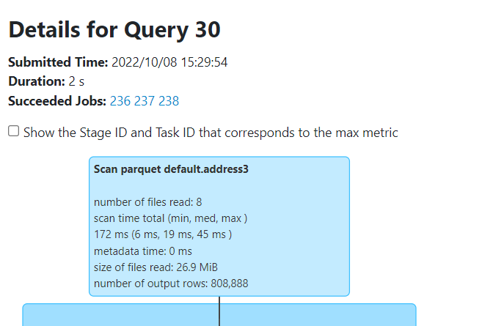
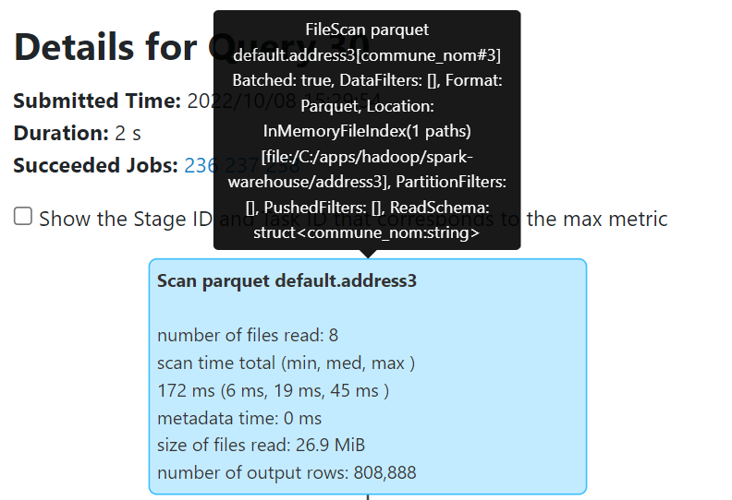
Answer Exercise: Column Pruning
Reading only column
« commune_nom#3 »
Total Size of files: 26.9 MiB
( will not be read fully)
Input : 667.6 KiB

Slide 63
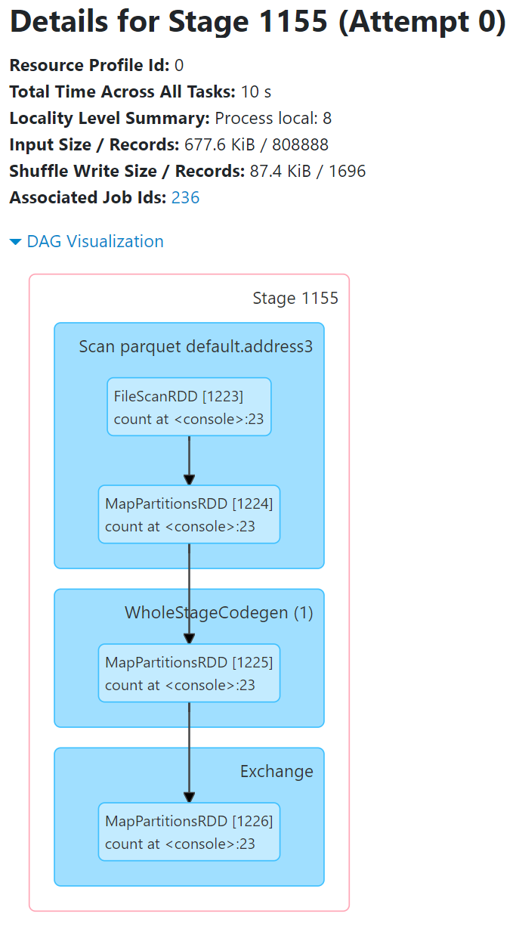
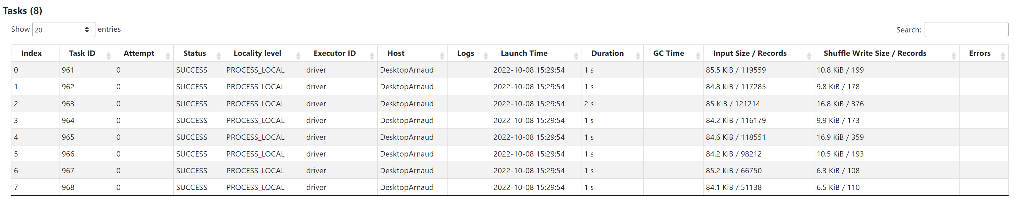
Answer Exercise: Column Pruning
Read 677.6 KiB
Details of Input Size / Records per Task

Slide 64
Exercise 20: Predicate-Push-Down
a/ Execute following Queries
select count(*) from db1.address where commune_nom = ‘Nanterre’
select count(*) from db1.address where UPPER(commune_nom) = ‘NANTERRE’
select count(*) from db1.address where commune_nom like ‘%Nanterre%’
b/ Check in SparkUI the execution Plan
Search for « PushedFilters:[ .. ] »
c/ For which query Spark is able to push down « some/all conditions » to parquet library ?
d/ explain how parquet files should be saved for having good read performances
Hint: use sc.setCallSite(« query comment») to find easily your query in Spark UI

Slide 65
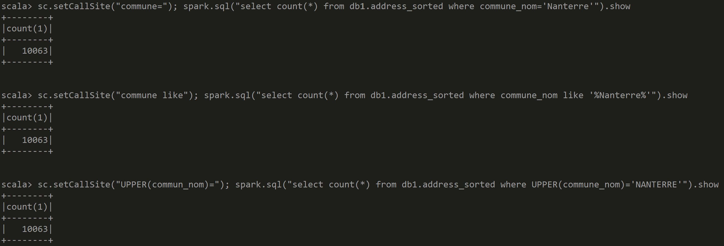
Answer Exercise: Predicate-Push-Down
This query OBVIOUSLY slower… see progress bar in console: ==========> [23/48]

Slide 66
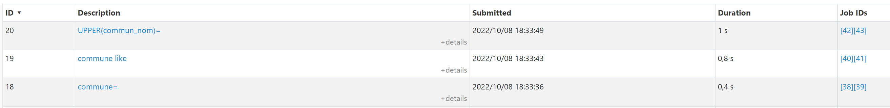





Answer Exercise:
WHERE commune=
WHERE commune like ‘%Nanterre%’
WHERE UPPER(commune)=
Condition NOT pushed-down
ONLY « IsNotNull» !!
…by chance, regexp can be converted to commune contains ‘Nanterre’
FULL Pushed BUT less efficient: StringContains
FULL Pushed EqualTo
In Details… Pushed « EqualTo »

Slide 67
Objectives of Hands-On
1/ Execution Plan, SQL Explain / dataset.explain
2/ Spark UI, DAG, Narrow/Wide Transformations
3/ RDD cache / checkpoint
4/ Partition Pruning / Columns Pruning / Predicate-Push-Down
5/ Parquet Optims ( Sort, Stats, Dictionary, Bloom, BlockSize)
6/ perfs: SpillToDisk, JOINs, hint

Slide 68
Exercise 20: prepare sorted parquet table for Predicate-Push-Down
We want to have few PARQUET files (1 or several, but not hundred)
Each PARQUET File split in several blocks of 16Mo (default=256Mo)
Each block sorted to have efficient Dictionaries and Min-Max Statistics
val allAdressCsvDs = spark.read.options(Map("header" -> "true", "delimiter" -> ";", "inferSchema" -> "true")).format("csv").load("C:/data/OpenData-gouv.fr/bal/adresses-france.csv")
.withColumn("dept", regexp_replace(col("commune_insee"), "0*(.*)...", "$1").cast("int"))
.withColumn("code", col("commune_insee").cast("int"))
allAdressCsvDs.repartition(1)
.sort("dept").sortWithinPartitions("dept", "code", "voie_nom")
.write.format("parquet").option("parquet.block.size", 16*1024*1024)
.saveAsTable("db1.address_sorted")
allAdressCsvDs.repartition(10, col("dept")) .sortWithinPartitions("dept", "code", "voie_nom")
.write.format("parquet").option("parquet.block.size", 16*1024*1024)
.saveAsTable("db1.address_sorted10")

Slide 69
Exercise 20 … write.option() or global --conf ??
Use
spark-shell --driver-memory=3g \ --conf spark.sql.files.maxPartitionBytes=16777216 \ --conf parquet.block.size=16777216

Slide 70
Exercise 21: check.. getNumPartitions
Check that
a/ table db1.address_sorted is saved on 1 parquet file, and file is split into 55 partitions giving a total of numPartition=55
b/ table db1.address_sorted10 is saved on 10 parquet files and files are split (differently..) giving a total of numPartition=57
c/ is there a big difference between a/ and b/ ? Which is « better » ?
Hint: use dataset.toJavaRDD.getNumPartitions

Slide 71


Answer Exercise 21
1 File 886 Mo
55 partitions
10 Files
between 40Mo - 130Mo ( total ~886 Mo)
57 partitions
(only 7 files are split in 2 all other have 1 part)

Slide 72
Answer Exercise 21: difference between 1 File-N Partitions <<>> N files- each 1 partition
In both case there is approximatly 55 partitions
But case a/ is MUCH BETTER
Because there is less files
No overhead to duplicate read File metadata (same schema+different offsets)
No overhead for the storage filesystem to store N files

Slide 73
Exercise 22: Predicate-Push-Down
Execute several Queries with WHERE clauses « field=value »
and see efficiency of Skipped/Read bytes compared to total file size
select count(*) from db1.address_sorted where …
a/ where commune_nom=‘Nanterre’
b/ where code=92050
c/ where commune_nom=‘_UneCommuneQuiNExistePas’
d/ where code=0
Compare Bytes read for queries… Are they same?
Compare Plan « PushedFilters: [ ..] » / Compare jobs->stage tasks counts
Hint: use « sc.setCallSite(« DisplayName »); » to find queries more easily in Spark UI

Slide 74

Answer Exercise 22:
So a != b, b != d
And it seems that a=c, b=d
For a|c => Spark need to read « code » statistics (minValue,maxValue), then Spark read all blocks matching
For b|d => Spark need to read « commune_nom » Bloom filter then Dictionaries, then Spark read all blocks matching

Slide 75

Answer Exercise 22:
Read Input Size per Tasks … There are 55 parallel tasks (but 1 File)

Slide 76

select on non-existing value
Execute
select count(*) from db1.address_sorted where …
a/ where commune_nom=‘__UneVilleQuiNExistePas’
b/ where code=9999999
Question:
What is still read by Spark ?

Slide 77
Answer Exercise 22:
15.0 < 15.2 MiB for existing one
18.6 < 18.9 MiB for existing one
In exercise 20, Spark could select data from matching page blocks
(obviously, using « select * » isntead of « select count(*) » requires more data )
Here, we are sure Spark only read Statistics / Bloom Filter / DictionaryPages

Slide 78
Objectives of Hands-On
1/ Execution Plan, SQL Explain / dataset.explain
2/ Spark UI, DAG, Narrow/Wide Transformations
3/ RDD cache / checkpoint
4/ Partition Pruning / Columns Pruning / Predicate-Push-Down
5/ Parquet Optims ( Sort, Stats, Dictionary, Bloom, BlockSize)
6/ perfs: SpillToDisk, JOINs, hint

Slide 79
Exercise 23: Detect SpillToDisk problems
When Spark has not enough RAM memory, it uses « swapping » to disk.
In Spark, this is called « SpillToDisk ».
This is a dreadfull signal, to ask for more memory (or better algorithm)
a/ execute a task taking to much memory … example a « .repartition(2).sortWithinPartitions(« commune_insee »)
b/ detect the slowness and diagnostic it in SparkUI
c/ retry executing same request with more memory, and compare performances

Slide 80

Exercise 23: SpillToDisk
Example:
spark.sql("select * from db1.addr3") .repartition(2).sortWithinPartitions("commune_insee") .write.saveAsTable("db1.addr_repart2")
Find other (more detailed) infos in SparkUI

Slide 81
Exercise 23 … detect SpillToDisk

Slide 82
Exercise 24: Join
a/ Extract and save from table address a new table « city »
Containing « name, code, dept, average_address_longitute, average_address_lattitude »
b/ Join table « address » and « city »,
and compute for each address the offset longitude/latitude to the city average center
c/ study Execution plan
check that Spark is already efficiently « Broadcasting » the small ‘city’ table => no need to « SortMerge » the big ‘addr’ table

Slide 83
Answer Exercise 24:
spark.sql(« SELECT commune_insee, commune_nom, count(*) as count_addr, avg(lat) as mid_lat, avg(long) as mid_long FROM db1.addr3 GROUP BY commune_insee, commune_nom ")
.repartition(10).sortWithinPartitions("commune_insee")
.write.saveAsTable("db1.city")
spark.sql(« SELECT a.*, (a.lat - c.mid_lat) as offset_lat, (a.long - c.mid_long) as offset_long FROM db1.addr3 a
JOIN db1. city c ON a.commune_insee=c.commune_insee
") .repartition(10).sortWithinPartitions("commune_insee") .write.saveAsTable("db1.addr_offset3")

Slide 84

Exercise 25: HINT to force join strategy
compare with previous Exercise 24/, but with SQL hinting SELECT /*+ MERGE(a) */ … FROM addr a …
Cf https://spark.apache.org/docs/latest/sql-ref-syntax-qry-select-hints.html

Slide 85
Optional Exercise 26: Default Shuffle = 200 ?!
Study number of partitions after a (« merge ») join (not a « broadcastjoin »)
a/ is it 200 ? Why
b/ How do you change default ?
c/ What should you always do before saving to File(s)?
(to avoid 200 small files)

Slide 86
Answer Exercise 26:

Slide 87
Exercise 27 : MindMap
Draw a MindMap to summarize
what you did and learn from this Hands-On session
Your MindMap should
start with word « Spark – Optimizations & RDD DAGs» in the middle
Then draw star edges to other word chapters and sub-chapters

Slide 88
Answer Exercise 27: MindMap
SQL: Explain [opt] <stmt>
HINT Api
SQL Hint
join
Dataset.explain(true)
Tuning broadcast,..
Logical/Physical Plan
.repartition(1) Files!
sort/repart + sortWithinPartition
RBO/CBO
DAG: Directed Acyclic Graph
blockSize=16M .. default=256M
Execution Plan
Spark UI – graph+text
statistics/dictionary/bloom
Action / Transformation
Predicate-Push-Down
Spark Optimisations-RDD & Dags
Narrow/WideTransformation
Lazy / Eager
SQL / Dataset API
Optims
Partition Pruning
Query > Jobs > Stages
Lazy/Eager
Narrow:
WholeStageCodeGen
Parquet
cache
Statistics
Bloom Filter
Shuffle..cached
Columnar Format
Column Pruning
Stage Skipped
debug.codeGen
Schema
Encoding
Dictionary
checkpoint
Wide: Shuffle
Green point
Exchange ouput/Input
Default shuffle =200 parts
Simplified lineage

Slide 89
Objectives of Hands-On
1/ Execution Plan, SQL Explain / dataset.explain
2/ Spark UI, DAG, Narrow/Wide Transformations
3/ RDD cache / checkpoint
4/ Partition Pruning / Columns Pruning / Predicate-Push-Down
5/ Parquet Optims ( Sort, Stats, Dictionary, Bloom, BlockSize)
6/ perfs: SpillToDisk, JOINs, hint

Slide 90
Questions ?

Slide 91
Take-Away What You learned ?

Slide 92
Next Steps
Unfortunatly, NO More Lessons
NO More Hands-On
But still, many more Spark concepts to learn :
Spark Clustering
Spark on Kubernetes, in Cloud
Java binding, UDF, map
Analytical Queries
Machine Learning
Spark Streaming
…

